Slide 1
Time Series Unit 9
Model Identification and Parameter Estimation

Slide 2
Break Out 1
Discuss the Texas Gas Price Analysis you conducted for the For Live Session assignment. Compare and contrast you results and discuss any questions or topics that come up along he way.

Slide 3
End Break Out 1

Slide 4
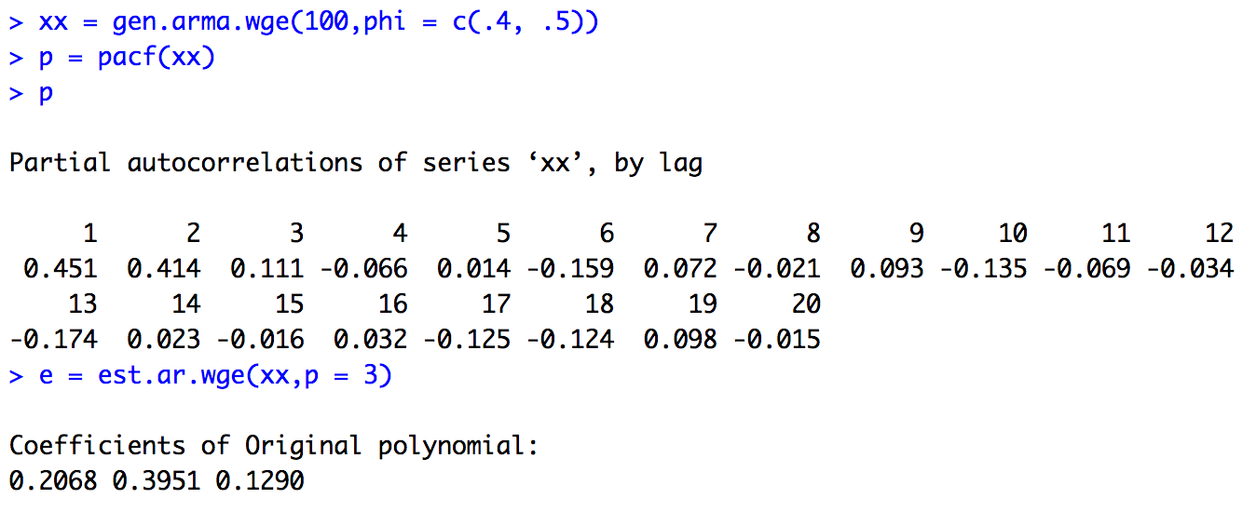
PACF Calculation Demo
xx = gen.arma.wge(100,phi = c(.4, .5))
p = pacf(xx)
p
e = est.ar.wge(xx,p = 3)
e = est.ar.wge(xx,p = 3,type = "yw")

Slide 5
Break Out 2
Use the Box-Jenkins model identification method (PACF) to identify the order of a model that best fits the data in the data set Unit9_2.csv.
Verify using est.ar.wge() the PACF values for lag = 1,2,3,4 and 5.

Slide 6
End Break Out 2

Slide 7
Break Out 3
Question from Asynch:
If you have roots close to 1, does this translate to wider confidence intervals to account for the instability? If so can you provide any additional insight?

Slide 8
End Break Out 3

Slide 9
Break Out 4

Slide 10
Identify and estimate a model that will be useful in forecasting the next 10 observations of the realization in the file: Unit9_1.csv.

Slide 11
End Break Out 4

Slide 12

Break Out 5
Identify and estimate a model that will be useful in forecasting the next 10 annual measurements of the level of Lake Huron.

Slide 13
End Break Out 5

